Slide 1

MARKET BASKET Analysis REPORT
9/5/2019

Slide 2
Summary
UNDERSTAND THE DATABASE
ASSOCIATIONS DISCOVERED
VISUALIZATION OF ASSOCIATIONS
TOP 10 ASSOCIATIONS
ITEMS FREQUENCY
QUESTIONS & RECOMMENDATIONS

Slide 3
Understand THE Database
9835 Transactions
125 Items
Itemset/Transaction:
Min. 1st Qu. Median Mean 3rd Qu. Max.
0 2 3 4 6 30

Slide 4
Associations Discovered
Set of 527 Rules
Rule Length Distribution (lhs + rhs):
1 | 2 | 3
10 | 385 | 132

Slide 5
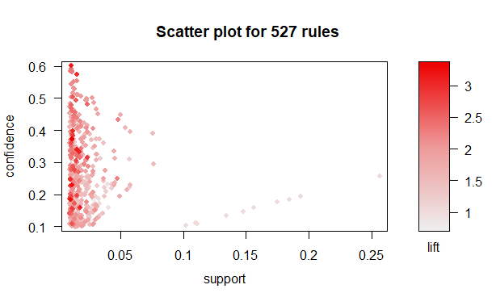
Visualize our Associations

Slide 6
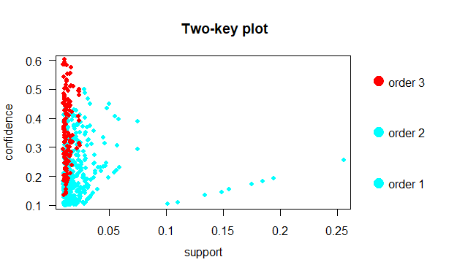

Slide 7
TOP 10 Associations
The People Who Bought | Likely Bought
{Acer Aspire,ViewSonic Monitor} {HP Laptop}
{ASUS 2 Monitor,Lenovo Desktop Computer {iMac}
{Apple Magic Keyboard, Dell Desktop} {iMac}
{ASUS Monitor,HP Laptop} {iMac}
{ASUS 2 Monitor,HP Laptop} {iMac}
{Dell Desktop,ViewSonic Monitor} {HP Laptop}
{Dell Desktop, ViewSonic Monitor} {iMac}
{Lenovo Desktop Computer,ViewSonic Monitor} {iMac}
{HP Laptop,Microsoft Office Home and Student 2016} {iMac}
{Acer Desktop,ViewSonic Monitor} {iMac}

Slide 8
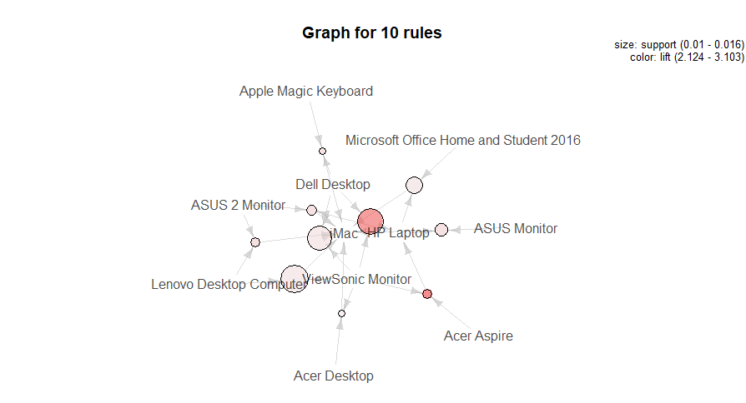

Slide 9
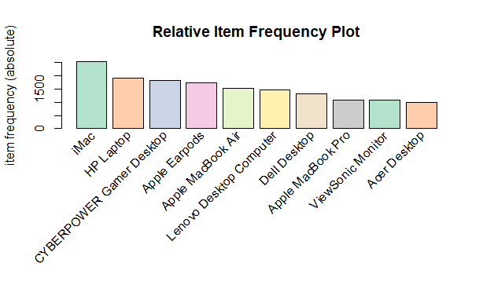
ITEMS FREQUENCY
Most Frequent Items:
iMac HP Laptop CYBERPOWER Gamer Apple EarPods Desktop Apple MacBook Air (Other)
2519 1909 1809 1715 1530 33622

Slide 10
Questions 1/2
Are there any interesting patterns or item relationships within Electronidex's transactions?
Yes, it looks like Electronidex’s customers buy a lot of there PCs and Laptops and associate them to different types of accessories.
Would Blackwell benefit from selling any of Electronidex's items?
Yes, it could be a great partnership for both parties, Blackwell will benefit from Electronidex traffic and quality on their Laptops and PC’s offers and Electronidex will extend their products categories to Smartphones, Software, Netbook…
In your opinion, should Blackwell acquire Electronidex?
Yes !

Slide 11
Questions 2/2
If Blackwell does acquire Electronidex, do you have any recommendations for Blackwell? (Ex: cross-selling items, sale promotions, should they remove items, etc.)
They surely must work on their Image as one Online Store Business, work on merging their products categories by removing any redundant, Both sides being able to deliver qualified visitors to their site. Visitors that will actually buy.
Building up a strong marketing channel that consistently drives people into the top selling products, cross-selling items and promote their sale through their Marketing Platforms, …

Slide 12
THANK you

